Slide 1


GIT Assignment TOPIC : MERGE
https://github.com/rastogiprakhar/GitAssignment
Presented By : Prakhar Rastogi
Employee ID : 1598

Slide 2

www.knoldus.com
WHAT IS GIT?
Git is a mature, actively maintained open source project originally developed in 2005 by Linus Torvalds, the famous creator of the Linux operating system kernel.
A staggering number of software projects rely on Git for version control, including commercial projects as well as open source.
WHAT IS GIT MERGE COMMAND?
Merging is Git's way of putting a forked history back together again.
The git merge command lets you take the independent lines of development created by git branch and integrate them into a single branch.

Slide 3
BASIC GIT COMMANDS
www.knoldus.com
Create a new local repository - git init
Check out a repository/Create a working copy of a local repository:git clone /path/to/repository
For a remote server, use: git clone username@host:/path/to/repository
Add files / Add one or more files to staging (index): git add <filename> / git add *
Commit / Commit changes to head : git commit -m "Commit message"
Push Send changes to the master branch of your remote repository: git push origin master
Status / List the files you've changed and those you still need to add or commit: git status

Slide 4
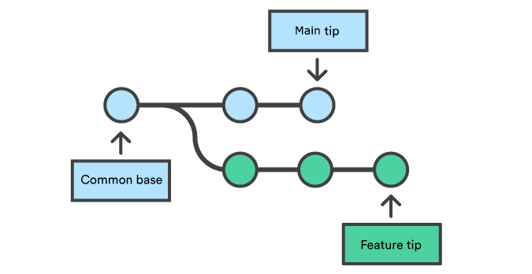
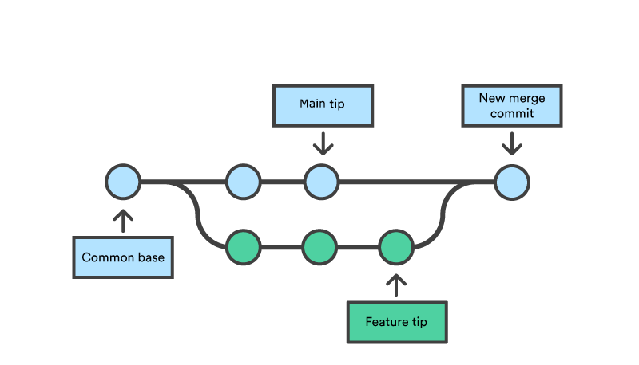
www.knoldus.com
Creating a branch
Merging into the Main branch

Slide 5
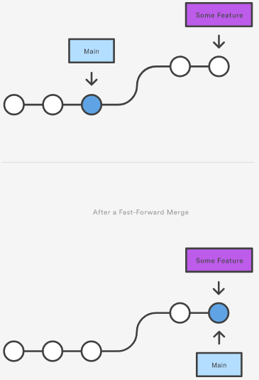
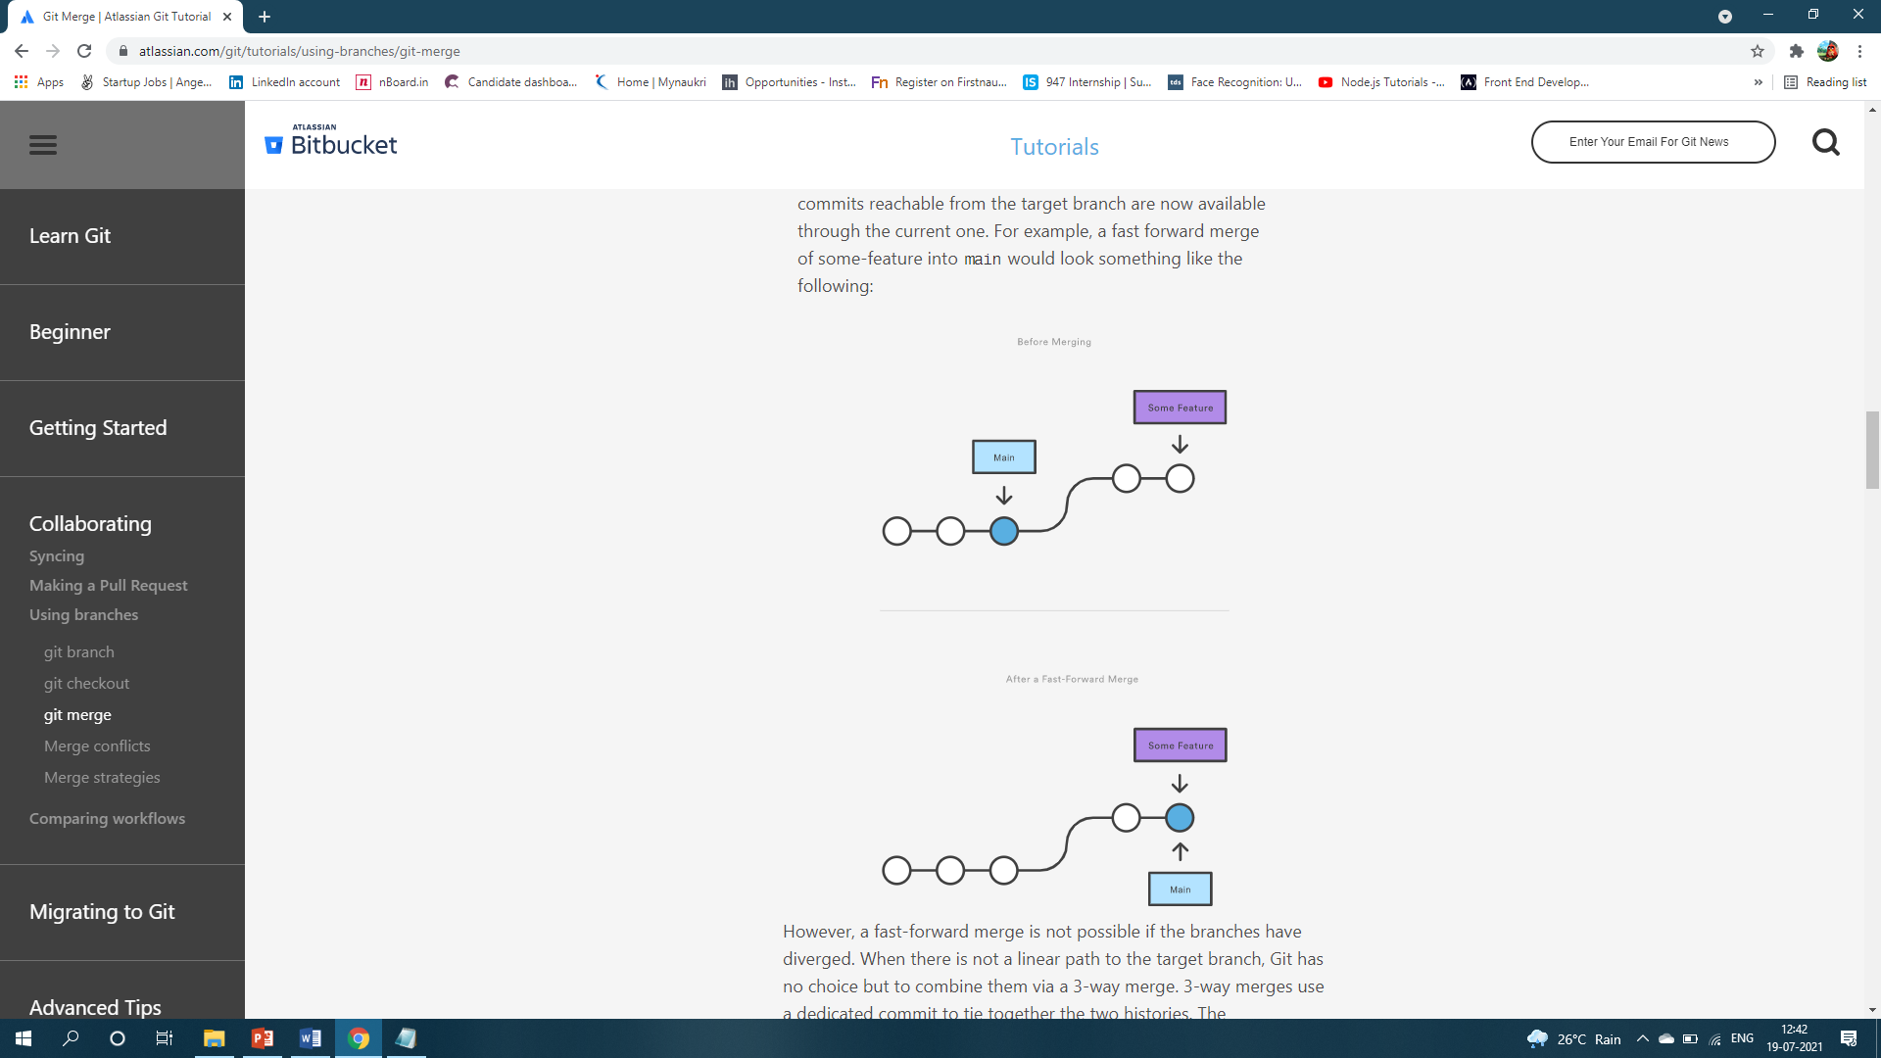
Fast Forward Merge
A fast-forward merge can occur when there is a linear path from the current branch tip to the target branch. Instead of “actually” merging the branches, all Git has to do to integrate the histories is move (i.e., “fast forward”) the current branch tip up to the target branch tip. This effectively combines the histories, since all of the commits reachable from the target branch are now available through the current one
www.knoldus.com
# Command
git checkout -b new-feature main
# Edit some files
git add <file>
git commit -m "Start a feature"
# Edit some files
git add <file>
git commit -m "Finish a feature"
# Merge in the new-feature branch
git checkout main
git merge new-feature
git branch -d new-feature

Slide 6
3-way merge
The next example is very similar, but requires a 3-way merge because main progresses while the feature is in-progress. This is a common scenario for large features or when several developers are working on a project simultaneously.
Start a new feature
git checkout -b new-feature main
# Edit some files
git add <file>
git commit -m "Start a feature"
# Edit some files
git add <file>
git commit -m "Finish a feature"
# Develop the main branch
git checkout main
# Edit some files
git add <file>
git commit -m "Make some super-stable changes to main"
# Merge in the new-feature branch
git merge new-feature
git branch -d new-feature
www.knoldus.com

Slide 7
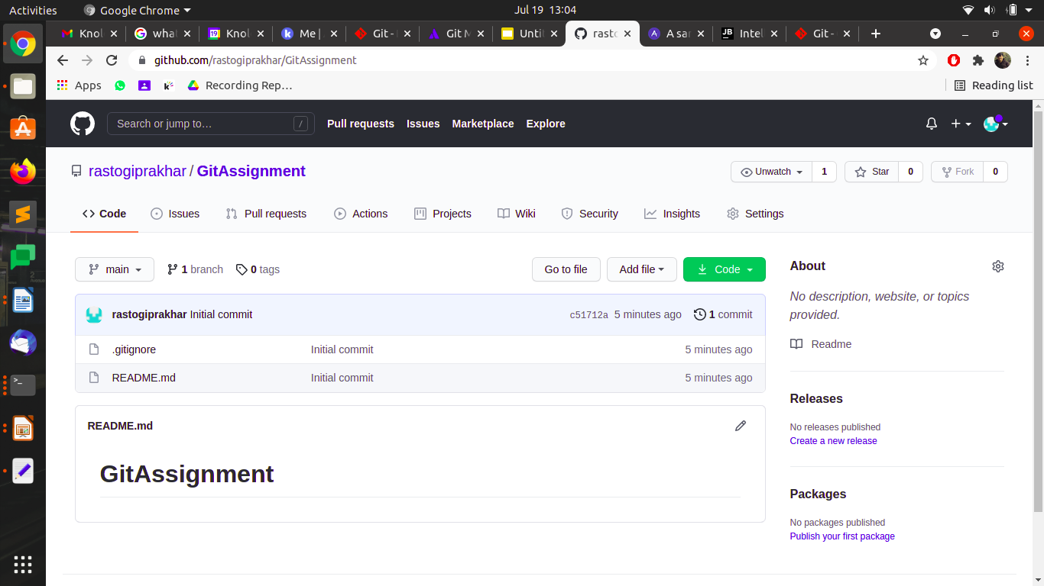
New Empty Repository
www.knoldus.com

Slide 8
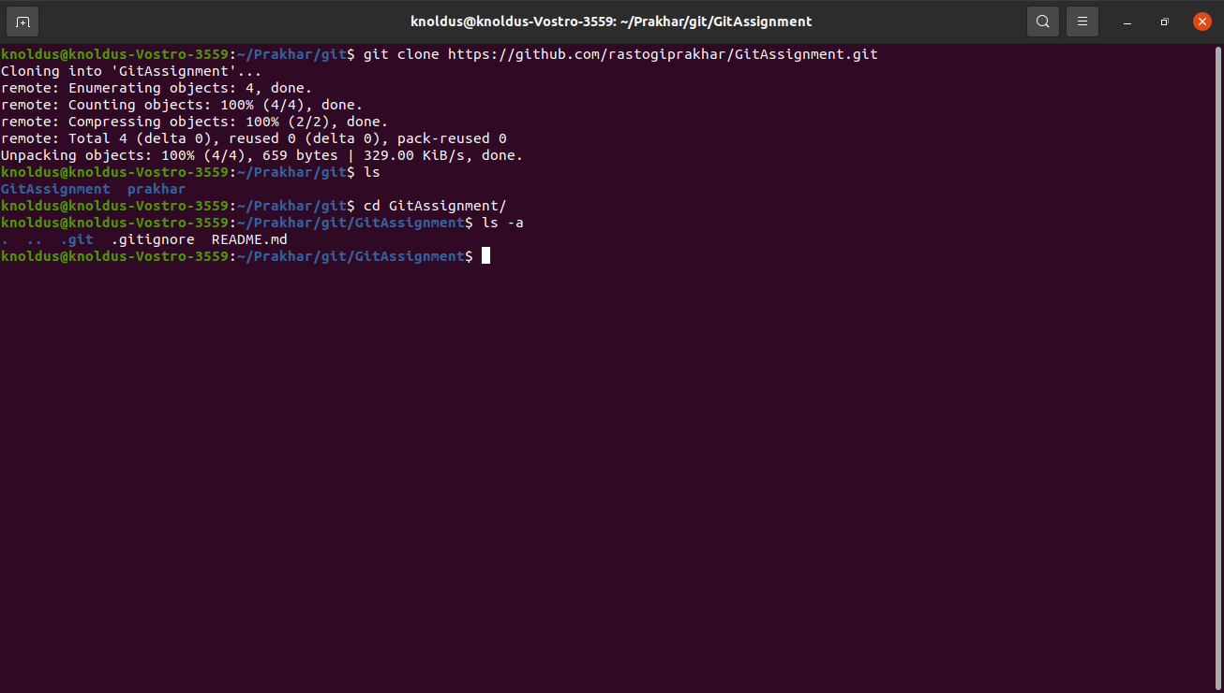
CLONING A REMOTE REPOSITORY
www.knoldus.com

Slide 9
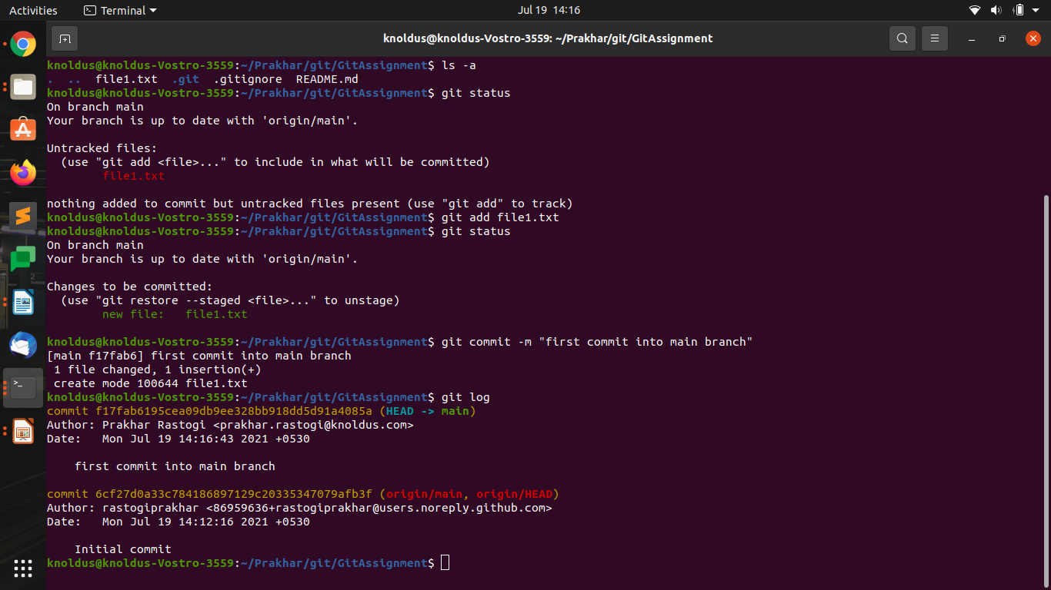
Using GIT Commit to capture a snapshot of the project's currently staged changes.
www.knoldus.com

Slide 10
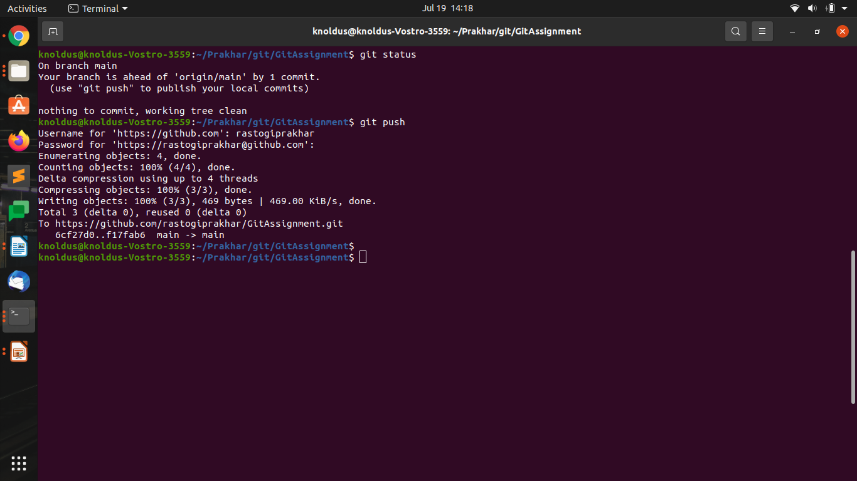
Using git push command to upload local repository content to a remote repository
www.knoldus.com

Slide 11
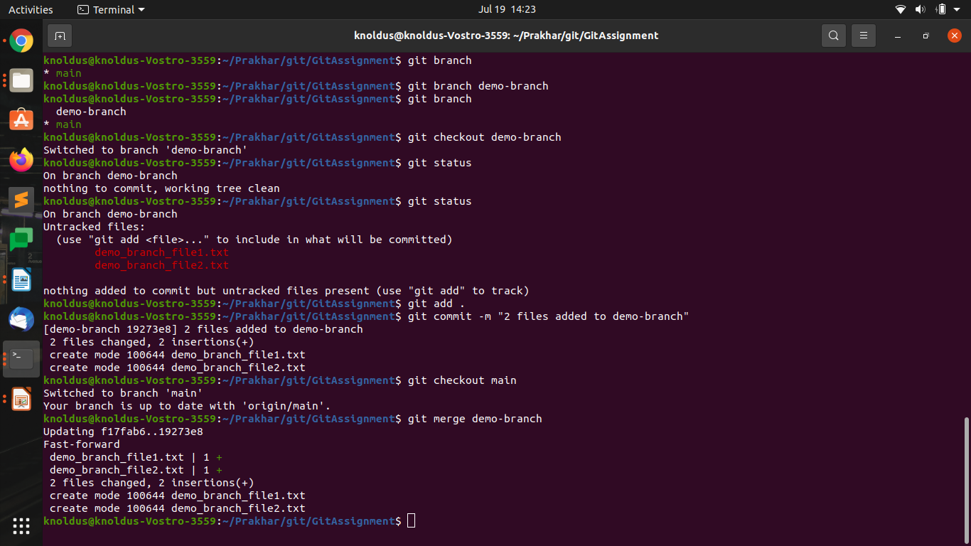
Using Git branch command that is effectively a pointer to a snapshot of your changes
www.knoldus.com

Slide 12
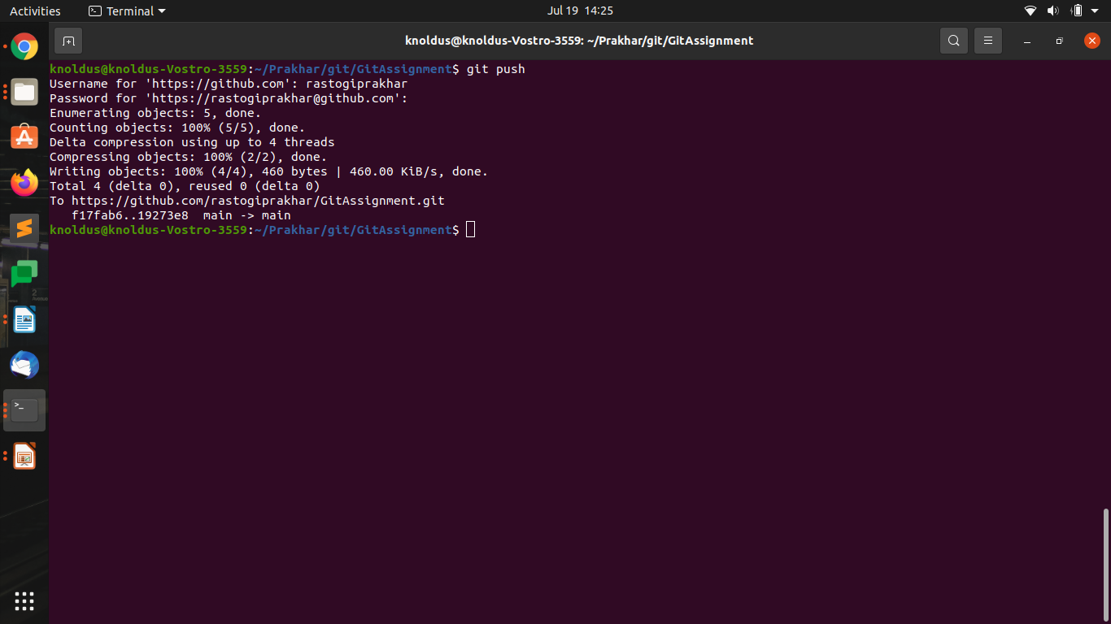
www.knoldus.com

Slide 13

Thank You!
Stay in Touch
https://www.facebook.com/KnoldusSoftware/
https://twitter.com/Knolspeak?ref_src=twsrc%5Egoogle%7Ctwcamp%5Eserp%7Ctwgr%5Eauthor

